Slide 1
Daily Study
2017/12/28
김서진

Slide 2
읽은 논문 리스트
Server Trace Analysis for an Optimal Design of Solid State Drives[IJAER’16] (17/12/05)
Write-off loading: Practical power Management for Enterprise Storage [FAST’08] (17/12/06~)
Don’t Let RAID Raid the Lifetime of your SSD Array [Hotstorage’13] (17/12/11~)
Addressing the Dark Side of Vision Research: Storage [Hotstorage’17] (17/12/21~)

Slide 3
Addressing the Dark Side of Vision Research: Storage [Hotstorage’17]
Goal
Improve visual processing run-times
Motivation
The storage research can strongly influence visual processing run-times:
efficient metadata storage and new storage formats for visual data.
Solution
Propose a storage architecture designed for efficient visual data access that exploits next generation hardware

Slide 4
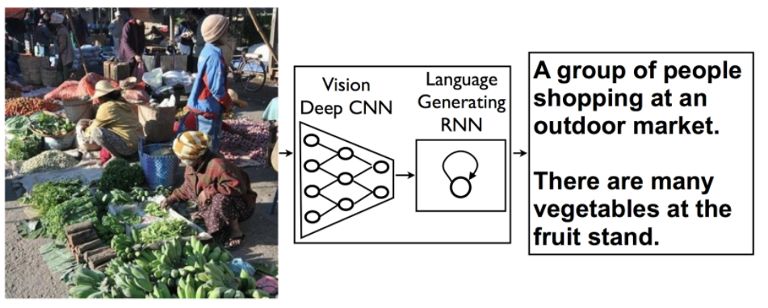
Today 공부한 내용
Deep learning algorithm
Supervised Methods
Deep Neural Networks
Recurrent Neural Networks
Convolutional Neural Networks

Slide 5
Today 공부한 내용
Vision Workload
Stream of incoming data or data from file system
Vision processing to extract metadata image classification identifying objects
Store data for future use
Queries for search of relevant data

Slide 6
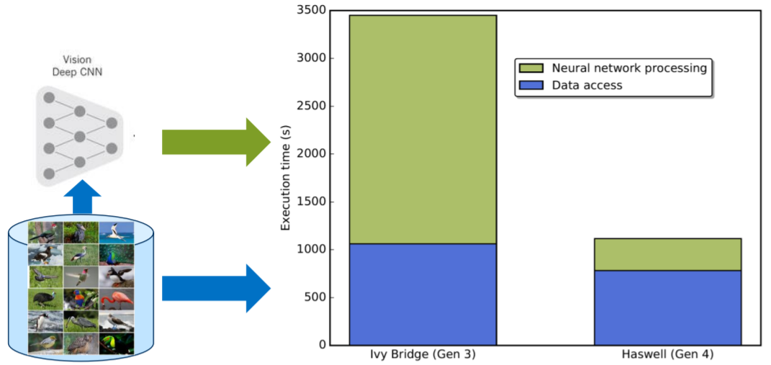
Today 공부한 내용
Storage is problem: data access time
Data access time is still problematic

Slide 7
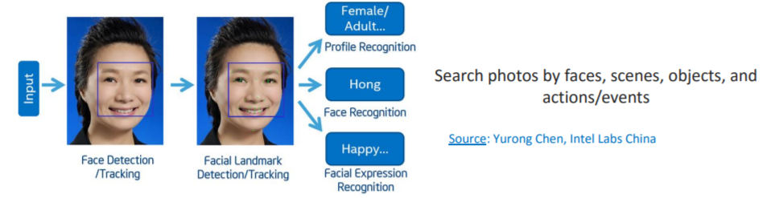
Today 공부한 내용
Image classification process
Exploit rich metadata
Way to speed up access to desired data: Analysis friendly formats

Slide 8
Today 공부한 내용
Common approach
Run the neural network again, an approach which is not scalable.
Exploit rich metadata
Way to speed up access to desired data: Analysis friendly formats

Slide 12
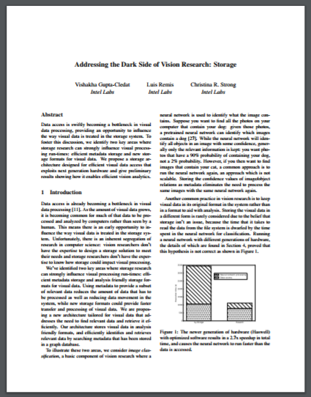
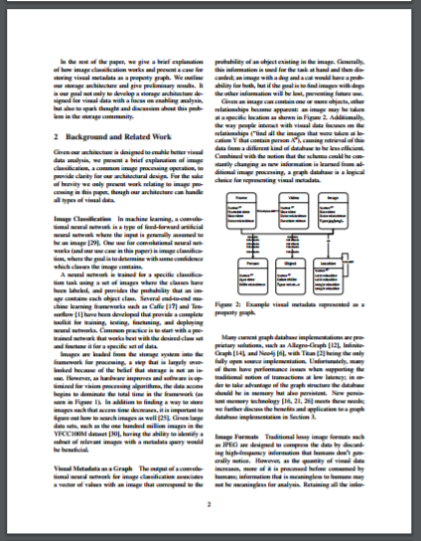
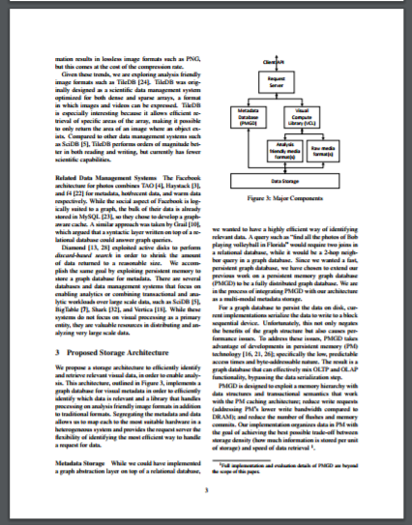
Today 공부한 내용
1p 2p 3p

